Slide 1
Prepare for Fall Filing with ReportMyUP
Casey Zieglmeier
Taylor Danko
Product Owner
Sr. Product Marketing Manager
10/07/2026

Slide 2
Disclaimer
Sovos does not provide tax, legal or accounting advice.
This webinar has been prepared for informational purposes only and is not intended to provide, and should not be relied on for, tax, legal or accounting advice. You should consult your own tax, legal and accounting advisors before engaging in any transaction.
Notes:
As a reminder this webinar does not provide tax, legal or accounting advice. It is for information purposes only.

Slide 3



Today’s Speakers
Casey Zieglmeier
Product Owner
Taylor Danko
Sr. Product Marketing Manager

Slide 4
01
Intro to Unclaimed Property
02
The Compliance Challenge
03
ReportMyUP Demo
04
Q&A

Slide 5
Intro to Unclaimed Property
01

Slide 6

What is Unclaimed Property?
Unclaimed property is money or assets held by a business that the rightful owner hasn't claimed for a set period of time, called the dormancy period. Think uncashed checks, forgotten refunds, unused gift cards, old account balances.
When that dormancy period expires, the state steps in as a custodian. The owner can still claim their money from the state at any time, it doesn't disappear.
Every industry generates unclaimed property. If your business issues payments, holds deposits, or carries balances owed to others, you're likely a holder with reporting obligations.
UP is not a tax
Notes:
So what actually is unclaimed property? UP is defined as a fixed and certain interest in intangible property that is held, issued, or owed in the course of a holder’s business that has gone unclaimed for a specific period of time by the rightful owner. That’s the complicated definition -
At its core, it's money your business is holding that the rightful owner hasn't touched for a certain period of time. That could be a payroll check someone never cashed, a customer refund that was never picked up, a security deposit, a gift card that went unused. At some point, if the owner doesn't come forward, those funds become reportable.
When that happens, the state steps in as a kind of custodian. They hold the money on the owner's behalf -- and the owner can still claim it from the state at any time. The money doesn't go away, it just moves. – END/PAUSE
The other thing I always want to flag early: this is not a tax. You are not paying a penalty to the government. You are returning property that belongs to someone else. That framing matters, because it changes how you think about the whole obligation and reporting as a whole.

Slide 7


Unclaimed Property
Common Terms & Definitions
Holder
Dormancy Period
The party who has the legal obligation to the owner of unclaimed property. Usually, the possessor or the unclaimed property.
The window of inactivity required before property becomes reportable. Varies by state and property type, typically 1 to 5 years.
Property Owner
Due Diligence
The person or entity entitled to the funds. Could be a former employee, a customer, a vendor.
Your required attempt to reach the owner before you report. Usually a written notice mailed 60 to 120 days before your filing deadline.
Last Activity Date
Negative/Zero Report
The most recent property owner-initiated contact
A filing you send to a state confirming you have nothing to report. Many states require it even when you owe nothing.
Notes:
A few terms you'll hear throughout the session.
A holder is the party who has the legal obligation to the owner of unclaimed property. For most of you on the call today, this could be you or simply your organization. If you issue checks, carry balances, or hold deposits, you're a holder.
Property owner – that is simply the rightful owner of the unclaimed property.
The last activity date is one of the most important concepts in this whole process. It’s the most recent property-owner initiated contact. This date is important because it has an effect on the next definition here which is dormancy period.
Dormancy period is a specified period of time before the property becomes reportable. It varies a lot -- by state, by property type but usually falls within the 1 to 5 year timeframe.
Due diligence is your obligation to try to reach the owner before you hand the property over to the state. Think of it as a last chance notice. It’s really the level of effort required to locate the owner prior to reporting and remitting the property to the state
And negative reports -- this one surprises people. If you have nothing to report in a given year it’s a report that you send to the state to show that, essentially.

Slide 8

Holder Obligations
1
2
3
4
Identify & Track
  Notify Owners
  File and remit
  Keep records
  Most states take the position that there is no statute of limitations for property not reported
  all property that could become reportable – aged payables, uncashed checks, open credits, dormancy accounts
  before the deadline – due diligence letters sent 60 to 120 days before filing.
    Submit your reports and sent the property to the state once dormancy is reached
    Most states expect 10+ years of documentation
Notes:
As a holder, you have four core obligations.
First, identify and track anything that could become reportable. That means staying on top of your aged payables, your uncashed checks, your open credits.
Second, notify owners. Before you report to the state, you are required to make a good faith attempt to reach the owner. That's the due diligence letter.
Third, file and remit. Submit the annual report and send the funds to the state. This is where it gets complex to do manually with several different thresholds, property type differences, portal logins, etc.
Fourth -- and this is the one that surprises people -- keep records. Most states expect ten or more years of documentation, so again if you’re doing this manually think about where you’re storing your data – and how feasible that is to continue.
And one other thing to note here that is really important in my opinion is most states have no statute of limitations on unreported property. If your company failed to report something years ago and it surfaces in an audit, you are still on the hook. That exposure does not expire. That's one of the biggest reasons organizations take this seriously once they actually understand the rules, because if you’re not doing anything and you get hit with an audit it can be really hard to combat that, especially without a program in place to track your properties.

Slide 9
The Compliance Challenge
02

Slide 10

Tracking &Identification
Identifying abandoned property, calculating dormancy, and managing codes across 50+ states.
The Compliance Problem
Unclaimed Property is More Than Just Filing
State Reporting
NAUPA-compliant files, cover sheets, direct submission — different rules for every jurisdiction.
Third-party auditors can look back years. Without a complete audit trail, your exposure is significant.
Audit Readiness
50+
States & jurisdictions with varying deadlines & rules
Each state has different letter requirements — timing, thresholds, format. Manual processes invite errors.
Due Diligence
$1B+
in unclaimed property escheated to the states annually
Deadlines & Enforcement
Filing dates vary by state and property type. Missed deadlines trigger penalties and audits.
Non-Compliance Risk
Penalties, interest, fines — plus the operational burden of multi-state audits by contract auditors.
Notes:
Alrigthy – getting into the compliance issues. So where does compliance come into play when it comes to unclaimed property?
Starting on the right side of the screen, you've got the operational challenges.
Tracking and identifying property – this means figuring out what's dormant, calculating dormancy across 50-plus states, managing property codes that vary by jurisdiction. That alone is a full-time job for some organizations.
State reporting means generating NAUPA-compliant files, cover sheets, and submitting directly to each state -- and the rules are different everywhere and can vary depending on what your reporting.
Then there's audit preparedness. Third-party auditors can look back years. If you don't have a clean audit trail, your exposure can compound fast.
Going down here-- due diligence. Every state has different letter requirements. Different timing windows, different thresholds, different format rules. If you're doing that manually, it is fairly easy to make a mistake or skip a requirement
Deadlines and enforcement – Like I sad before, filing dates vary by state and property type, and missed deadlines don't just mean a late fee. They can trigger audits.
And non-compliance risk isn't just financial. Penalties, interest, fines – it’s the operational weight of surviving a multi-state audit, which can take months if not years to complete.
The stats on the left tell you why this matters at scale. 50-plus jurisdictions. Over a billion dollars escheated to states annually. And state enforcement is increasing year over year -- this isn't getting easier.
This is why organizations managing this across spreadsheets, calendar reminders, and manual letter processes – often can’t keep up because That's not a compliance program. . Or another scenario we see a lot – businesses not doing any reporting at all.. That’s just asking for trouble – and by trouble I mean fines, penalties, audits, reputational damage, time from your employees, and more.

Slide 11
ReportMyUP Intro & Demo
03

Slide 12

50+
30+
10+
The Solution
ReportMyUP
States & territories supported, including Quebec, PR, and USVI
States accept direct online submission from the platform
Years of leading unclaimed property compliance
Dormancy Calculation
Due Diligence Letters
State Reporting
Audit Trail
Centralized Property Management
Add, track, filter, and update all unclaimed property records in one place — with bulk import support.
Automatic calculation of due dates based on state, business type, and property type.
Generate state-compliant letters from our standard template. Full letter history automatically archived and available on demand.
Direct submission to 30+ states and NAUPA-format files and coversheets for all states. Full reporting history automatically archived and available on demand.
Per-property audit trails available on demand with mailing and reporting timestamps.
12
© Sovos 2025. Proprietary and Confidential

Slide 13
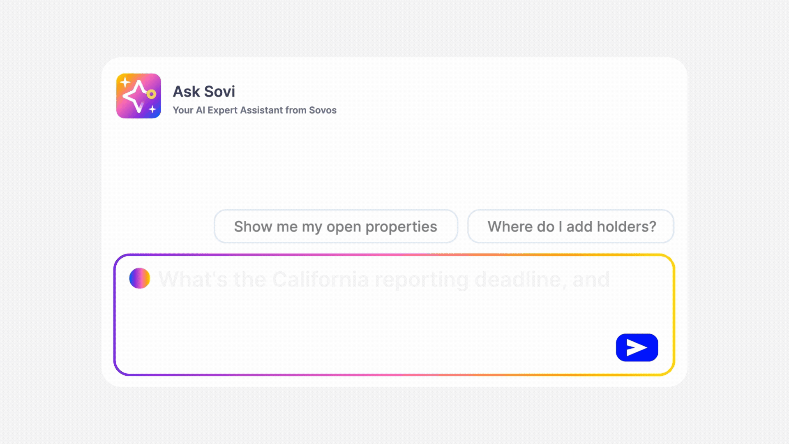
Ask Sovi® Q&A
Your AI compliance expert is always-on, ready to answer your product and compliance questions in seconds.
Instant Answers, No Wait Time
Skip the support queue. Ask Sovi answers regulatory and product questions the moment you need them.
Know Your Compliance Obligations
Ask Sovi helps your team research, prepare, and stay informed on regulatory requirements and deadlines.
Fewer Interruptions, More Productivity
Get answers to complex compliance questions without looping in your compliance team every single time.
Already Available.
Ask Sovi is live in ReportMyUP today.

Slide 14
State Reporting
It's simple if you are prepared
1
2
3
4
Notify internal stakeholders
Review and update company information
Review Negative Report Summary
Preview Reports
Report Signer
Approvals
Remittance
Claim cut-off
Company information pulls on to the state report.
Most of the conditional negative report requirements are based on report history.
Early Preview Reports can save a lot of time and effort.

Slide 15
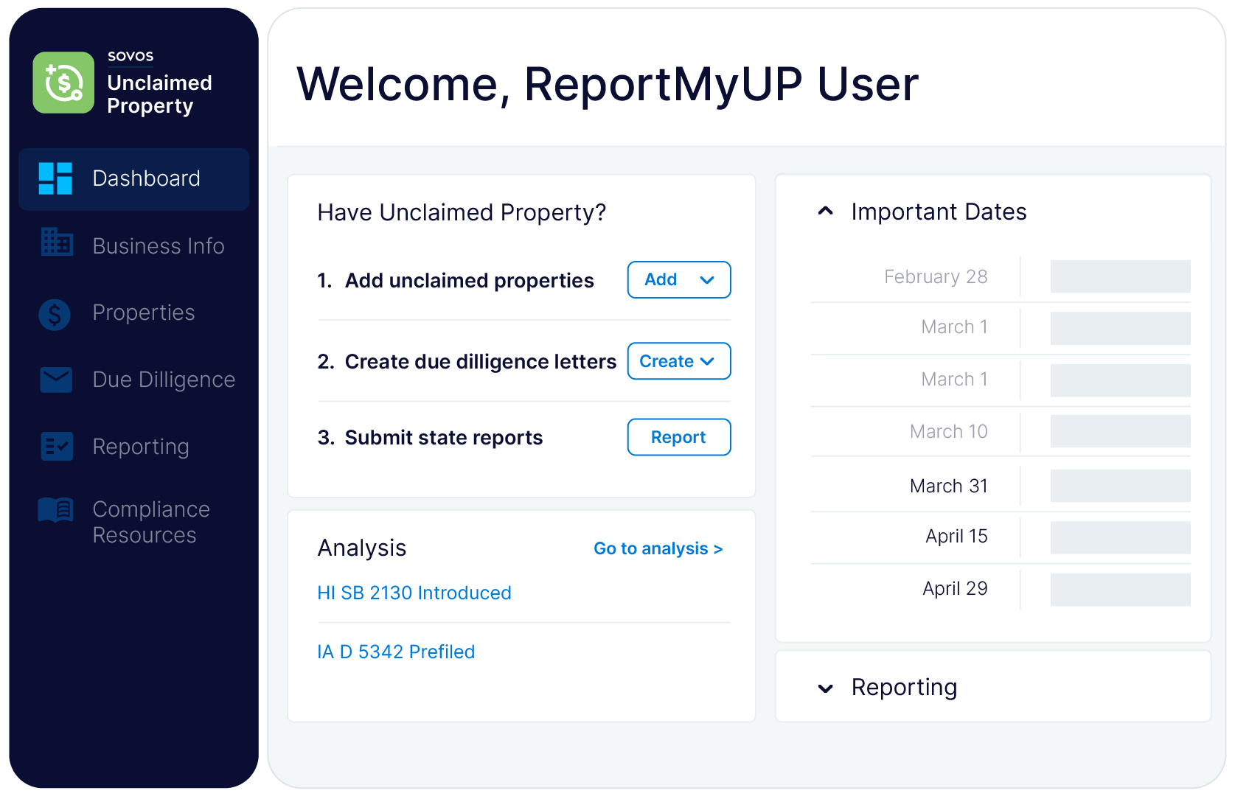
What We’ll Walk Through
Getting Data in
Managing & Tracking Properties
Due Diligence
State Reporting
Audit Readiness

Slide 16
Q&A
04

Slide 17
Q&A

